Slide 1
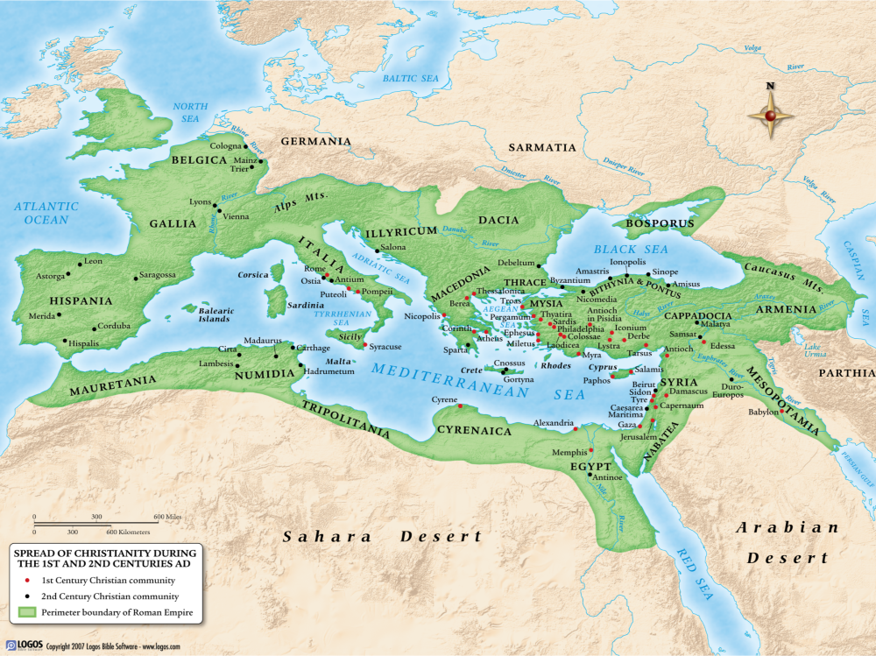

Slide 2
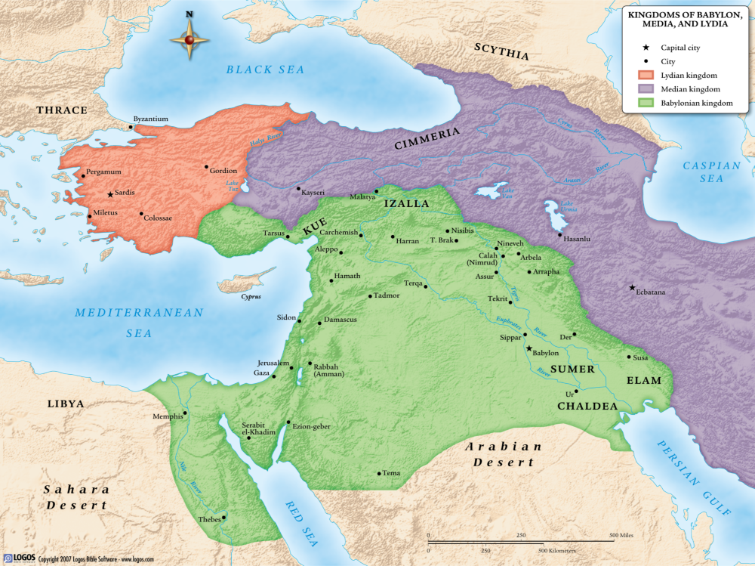

Slide 3
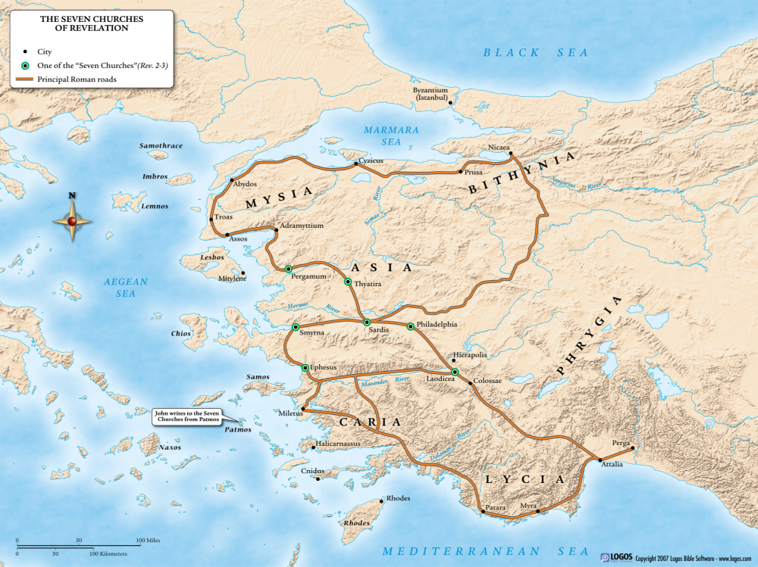

Slide 4
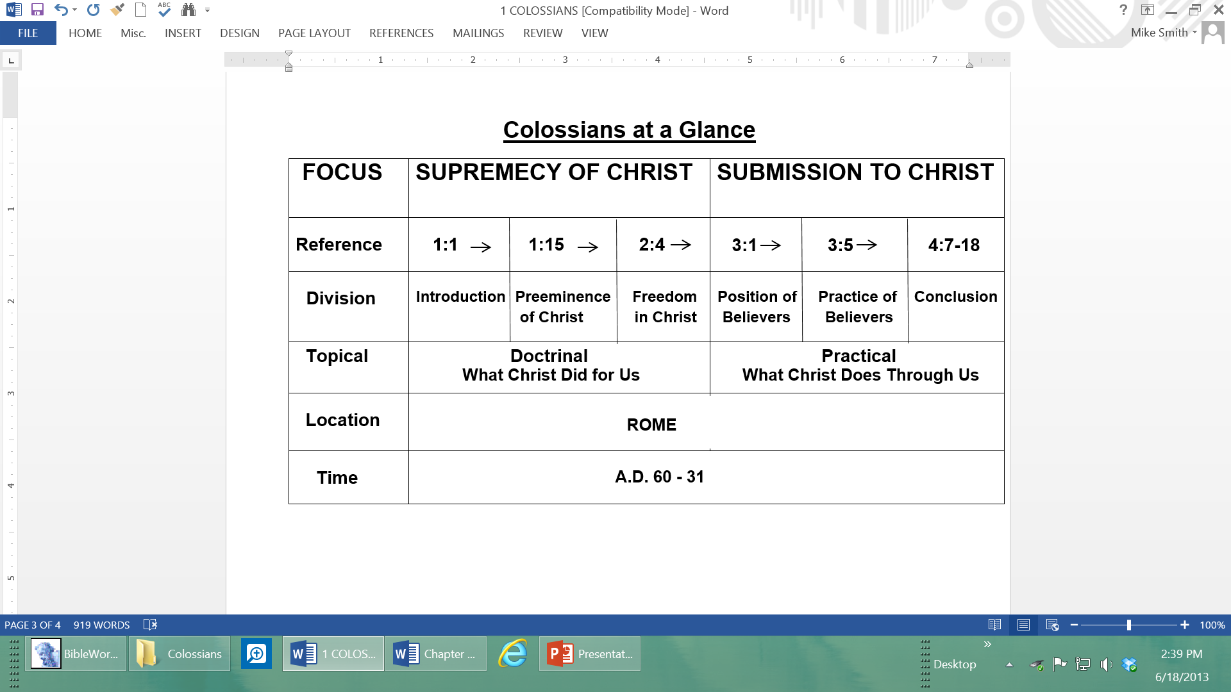

Slide 5
OUTLINE OF COLOSSIANS
PART ONE: The Supremacy of Christ in the Church (1:1–2:23)
I. Introduction 1:1–14
A. Paul’s Greeting to the Colossians 1:1, 2
B. Paul’s Thanksgiving for the Colossians 1:3–8
C. Paul’s Prayer for the Colossians 1:9–14
II. The Preeminence of Christ 1:15–2:3
A. Christ Is Preeminent in Creation 1:15–18
B. Christ Is Preeminent in Redemption 1:19–23
C. Christ Is Preeminent in the Church 1:24–2:3
III. The Freedom in Christ 2:4–23
A. Freedom from Enticing Words 2:4–7
B. Freedom from Vain Philosophy 2:8–10
C. Freedom from the Judgment of Men 2:11–17
D. Freedom from Improper Worship 2:18, 19
E. Freedom from the Doctrine of Men 2:20–23

Slide 6
PART TWO: The Submission to Christ in the Church (3:1–4:18)
I. The Position of the Believer 3:1–4
II. The Practice of the Believer 3:5–4:6
A. Put Off the Old Man 3:5–11
B. Put On the New Man 3:12–17
C. Personal Commands for Holiness 3:18–4:6
III. Conclusion 4:7–18
A. Commendation of Tychicus 4:7–9
B. Greetings from Paul’s Friends 4:10–14
C. Introductions Regarding This Letter 4:15–18

Slide 7
THE OUTLINE OF CHAPTER ONE
Verses 1-2 The salutation
Verses 3-8 Thanksgiving for the Colossian’s faith
Verses 9-12 Prayer for their spiritual growth in God’s plan
Verses 13-20 The uniqueness of Jesus Christ
Verses 21-23 Challenge to the Colossians
Verses 24-29 Christ’s commission to Paul

Slide 9
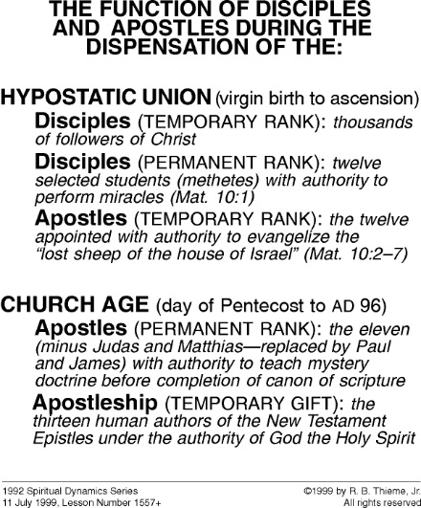
JEWS
p
PRE-CANON PERIOD OF THE CHURCH AGE

